Slide 1
Scientific Machine Learning for Modeling, Optimization, and Control of Dynamical Systems
Ján Drgoňa
Associate Professor Civil and Systems Engineering Department The Ralph O'Connor Sustainable Energy Institute (ROSEI)
Data Science and AI Institute (DSAI)

Slide 2
Course Syllabus
Week 1: Introduction to Scientific Machine Learning (SciML)
Week 2: Preliminaries and Introduction to differentiable programming
Week 3: Physics-informed neural networks (PINNs)
Week 4: Neural ordinary differential equations (NODEs)
Week 5: Learning to optimize (L2O)
Week 6: Optimal control preliminaries
Week 7: Learning to control (L2C)
Week 8: Neural differential and difference equations with constraints
Week 9: Differentiable optimization
Week 10: Feasibility layers and safety filters
Week 11: Predict then optimize: decision focused learning
Week 12: Project evaluation with presentations
Week 13: Project evaluation with presentations

Slide 3
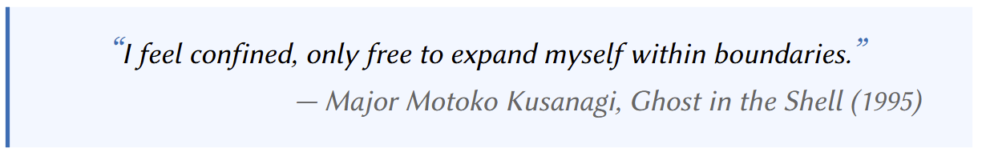

Differentiable Optimization
Brandon Amos, J. Zico Kolter, OptNet: Differentiable Optimization as a Layer in Neural Networks, ICML, 2017
Agrawal, A. and Amos, B. and Barratt, S. and Boyd, S. and Diamond, S. and Kolter, Z., Differentiable Convex Optimization Layers, NeurIPS 2019
James Kotary, My H. Dinh, Ferdinando Fioretto, Backpropagation of Unrolled Solvers with Folded Optimization, IJCAI, 2023
Quill Healey, Parth Nobel, Stephen Boyd, Differentiating Through a Quadratic Cone Program, 2025
https://implicit-layers-tutorial.org/differentiable_optimization/

Slide 4
Literature on Differentiable Optimization and Feasibility Layers
Brandon Amos, J. Zico Kolter, OptNet: Differentiable Optimization as a Layer in Neural Networks, ICML, 2017
Agrawal, A. and Amos, B. and Barratt, S. and Boyd, S. and Diamond, S. and Kolter, Z., Differentiable Convex Optimization Layers, NeurIPS 2019
James Kotary, et al., End-to-End Constrained Optimization Learning: A Survey, IJCAI, 2021
P. Donti, et al., DC3: A learning method for optimization with hard constraints, 2021
M. Li, et al., Learning to Solve Optimization Problems with Hard Linear Constraints, 2022
R. Sambharya, et al., End-to-End Learning to Warm-Start for Real-Time Quadratic Optimization, 2022
James Kotary, My H. Dinh, Ferdinando Fioretto, Backpropagation of Unrolled Solvers with Folded Optimization, IJCAI, 2023
E. King, J. Kotary, F. Fioretto and J. Drgoňa, "Metric Learning to Accelerate Convergence of Operator Splitting Methods," CDC, 2024
Rajiv Sambharya, Georgina Hall, Brandon Amos, Bartolomeo Stellato; Learning to Warm-Start Fixed-Point Optimization Algorithms, JMLR, 2024
Quill Healey, Parth Nobel, Stephen Boyd, Differentiating Through a Quadratic Cone Program, 2025
Maximilian Schaller, Stephen Boyd, Code generation for solving and differentiating through convex optimization problems, 2025
Pascal Van Hentenryck, Optimization learning, arXiv:2501.03443, 2025
Rajiv Sambharya, Jinho Bok, Nikolai Matni, George Pappas, Learning Acceleration Algorithms for Fast Parametric Convex Optimization with Certified Robustness, 2025
https://implicit-layers-tutorial.org/differentiable_optimization/

Slide 5
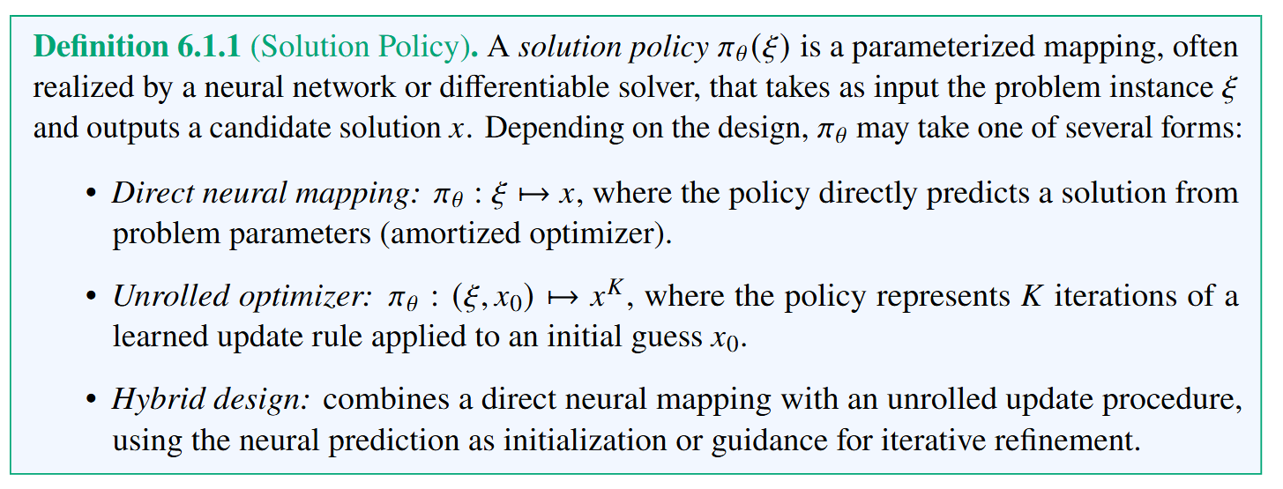
L2O Policy Representation

Slide 6
Differentiating Through the Optimization Solver
Differentiable optimization layers expose the sensitivity of optimization solutions to parameters, enabling end-to-end learning with an optimization problem inside the computation graph.
Two ways of differentiating through optimization program:
Fixed-point differentiation, based on either unrolling iterative solvers (backpropagation through time) or applying the implicit function theorem (IFT) at a fixed point
KKT-based differentiation, which differentiates the Karush–Kuhn–Tucker (KKT) optimality system directly using IFT.

Slide 7
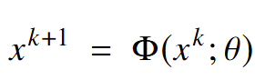
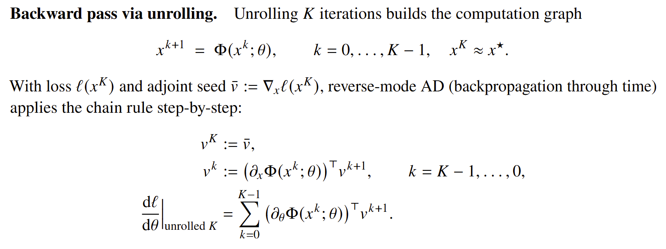
Fixed-point Differentiation Through Unrolled Solver Iterates
Fixed-point solver:
Examples: Newton's method, Runge–Kutta, …
https://en.wikipedia.org/wiki/Fixed-point_iteration
https://en.wikipedia.org/wiki/Backpropagation_through_time

Slide 8
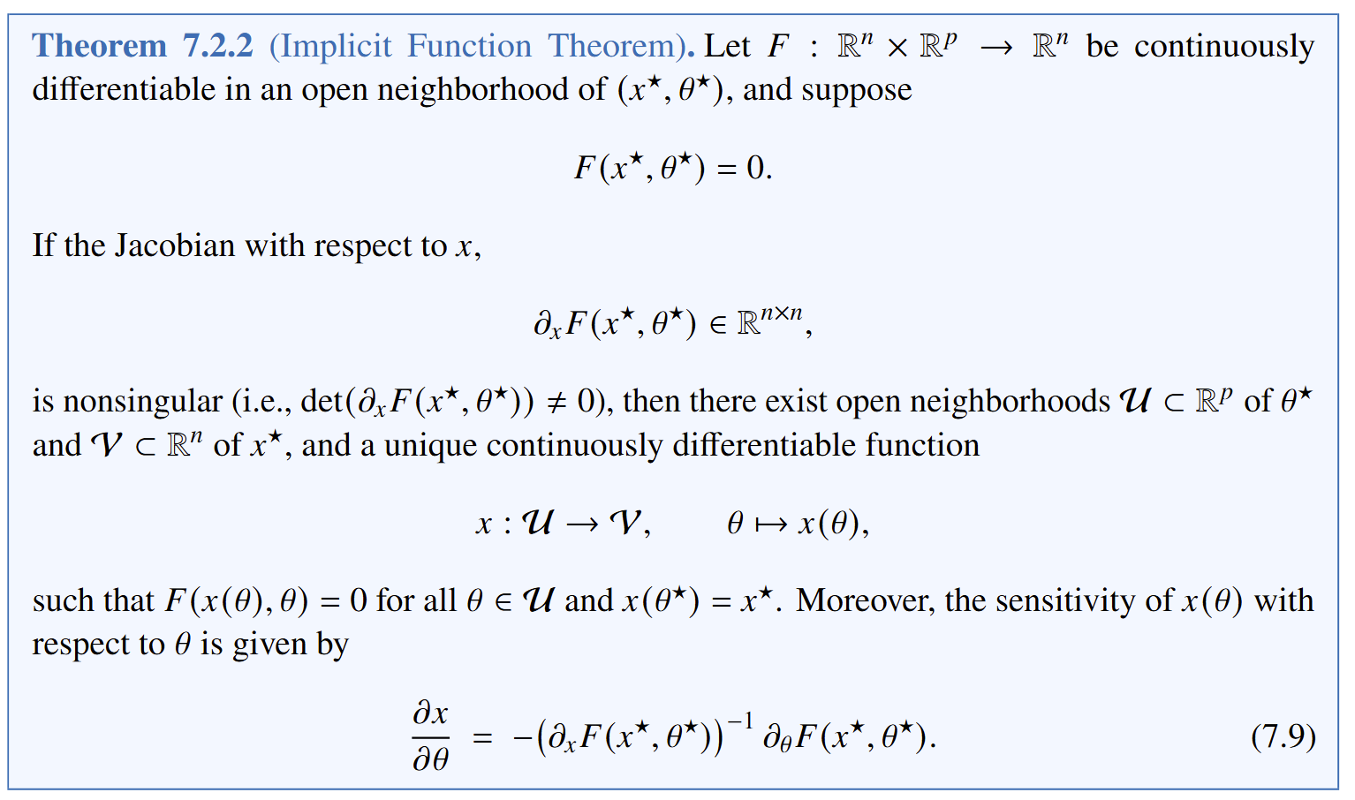
Implicit Function Theorem (IFT)

Slide 9
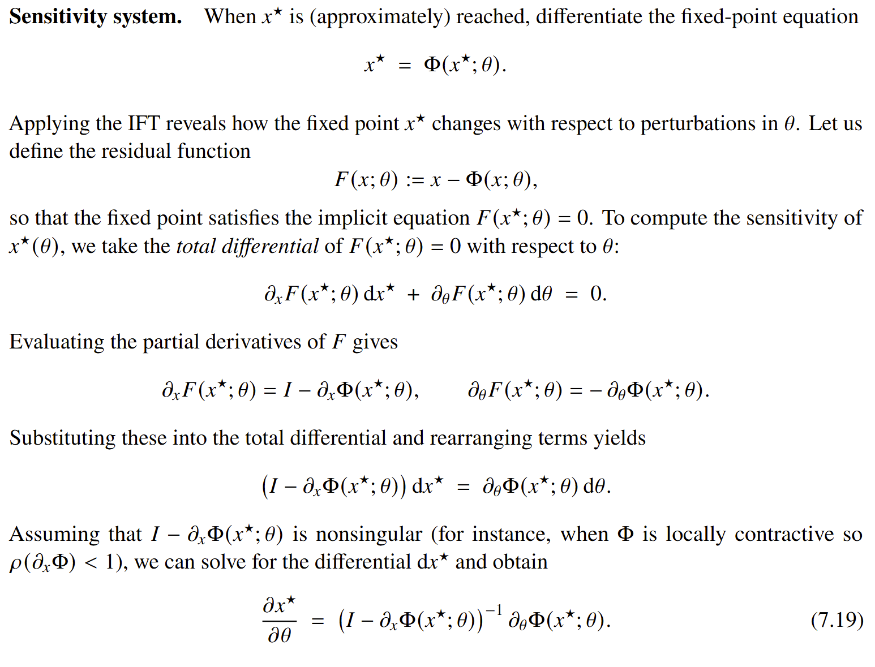
Implicit functions and automatic differentiation

Slide 10
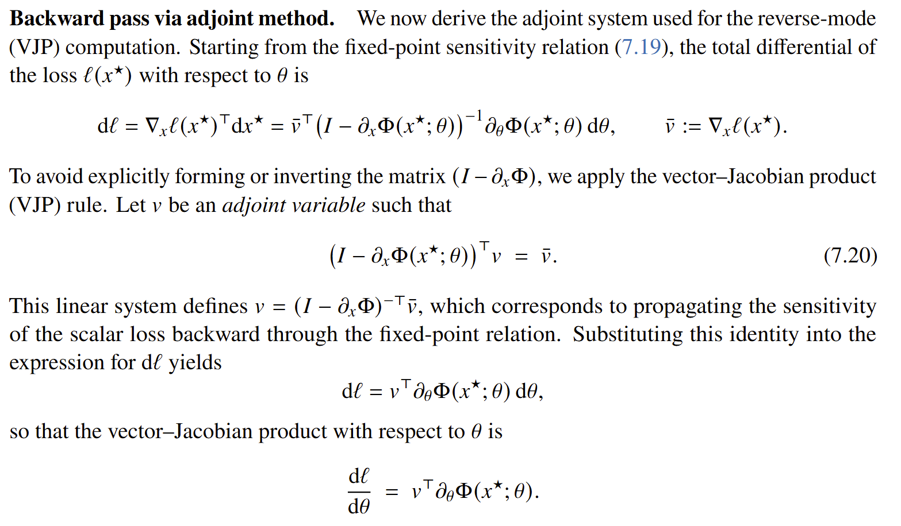
Adjoint Sensitivity of the Fixed-point Solver

Slide 11
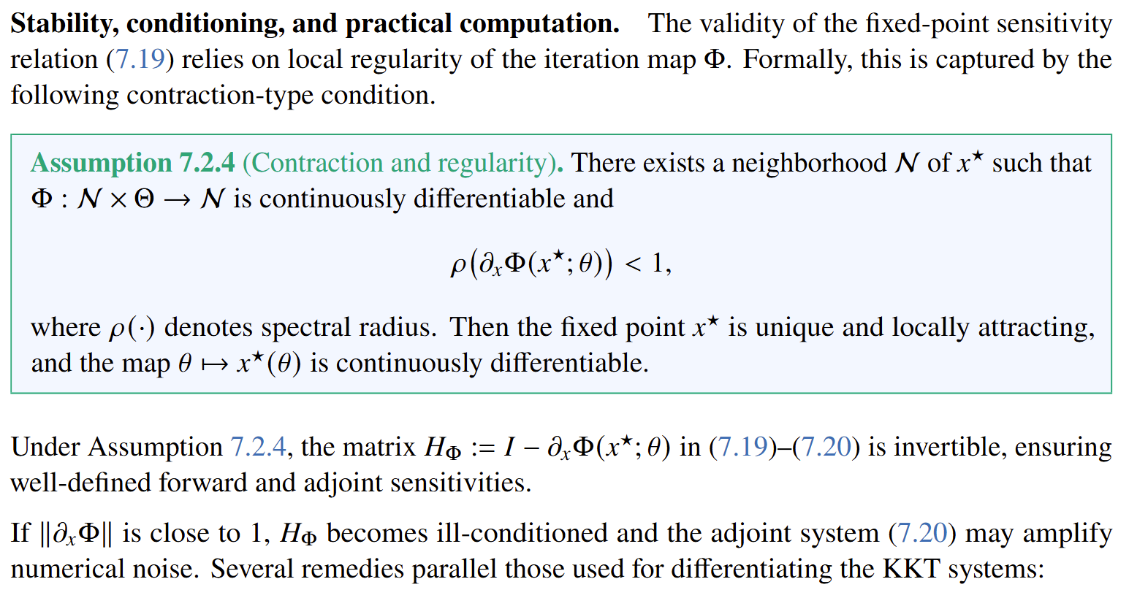
Stability and Conditioning of a Fixed-point Solver

Slide 12
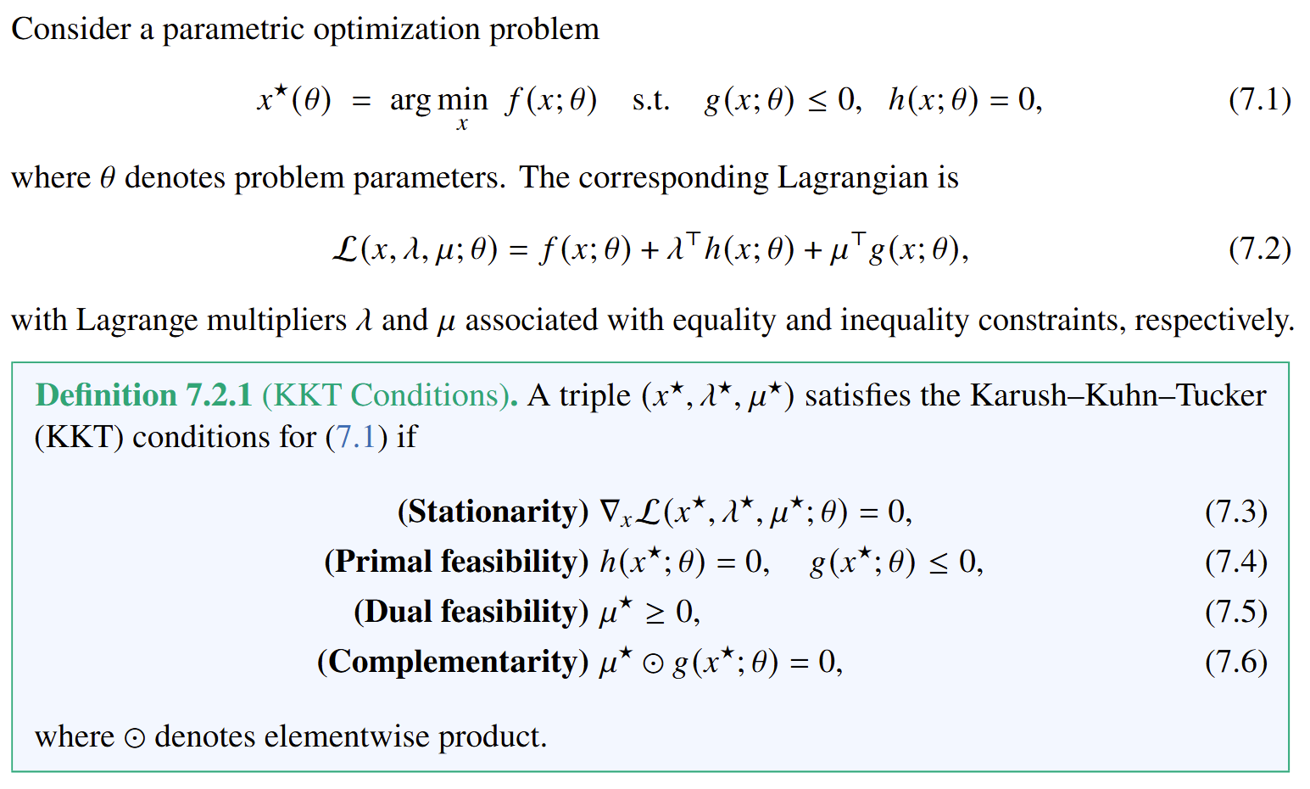
Karush-Kuhn-Tucker (KKT) Conditions

Slide 13
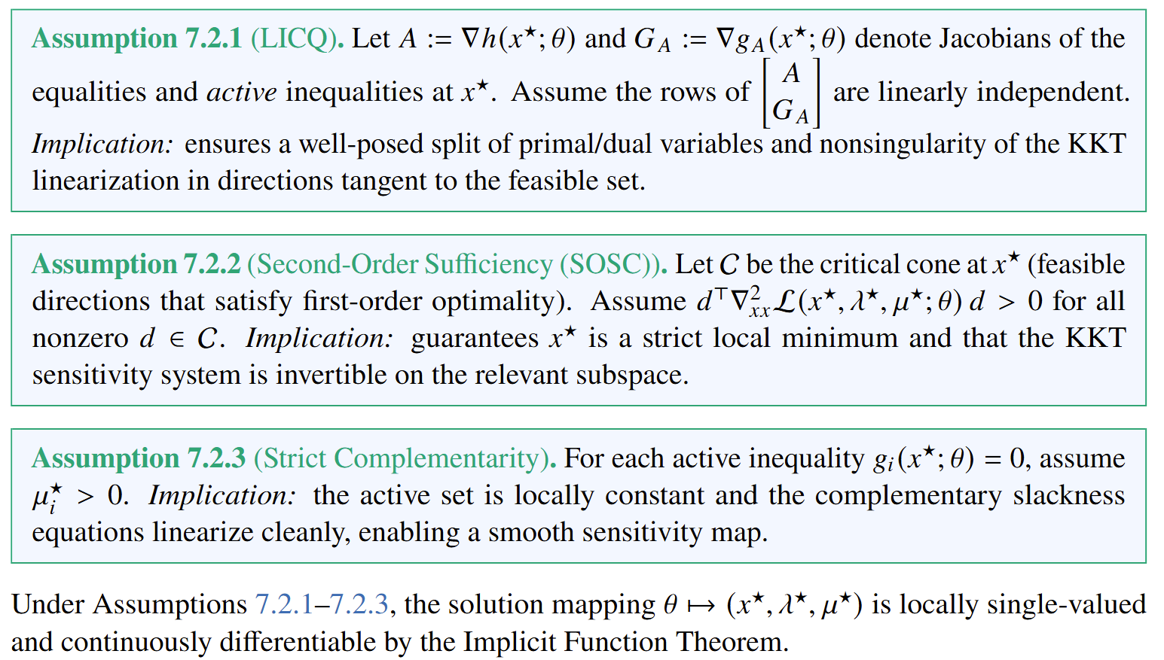
Assumptions

Slide 14
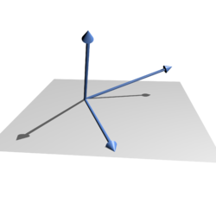
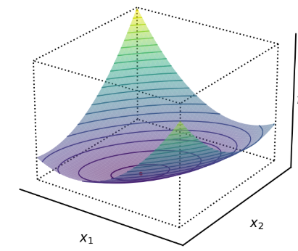
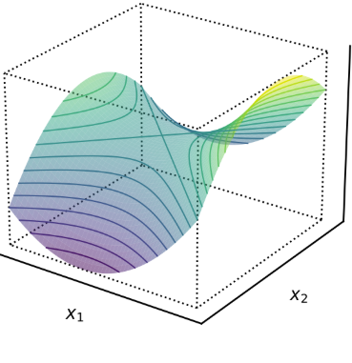
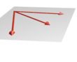
Assumptions
Assumption | Intuition | Ensures
LICQ | Constraints meet cleanly → feasible manifold is smooth | Unique multipliers, full-rank Jacobian
SOSC | Lagrangian has positive curvature on feasible directions | Local minimum, invertible Hessian block
Strict Complementarity | Each active inequality applies nonzero force | Constant active set, smooth mapping
Linearly independent
vs dependent vectors.
Positive definite
vs indefinite Hessian.
https://en.wikipedia.org/wiki/Linear_independence
https://en.wikipedia.org/wiki/Definite_matrix

Slide 15
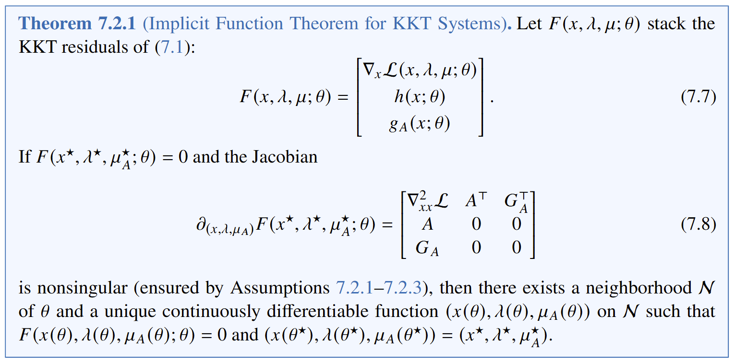
Implicit Function Theorem for KKT System

Slide 16
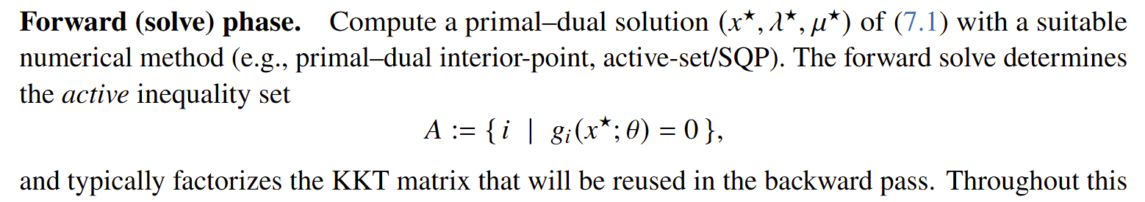
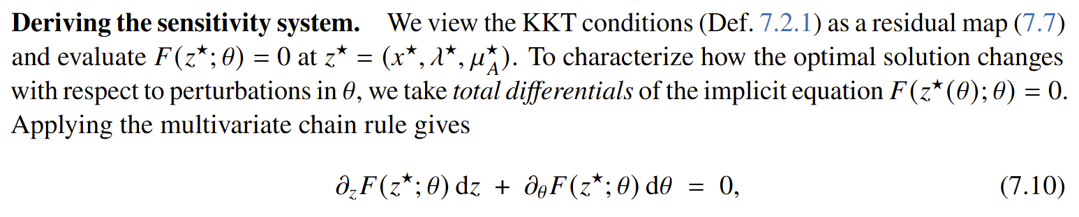
KKT-based Differentiation
Starts from the optimality system itself and differentiates the KKT conditions using IFT.

Slide 17
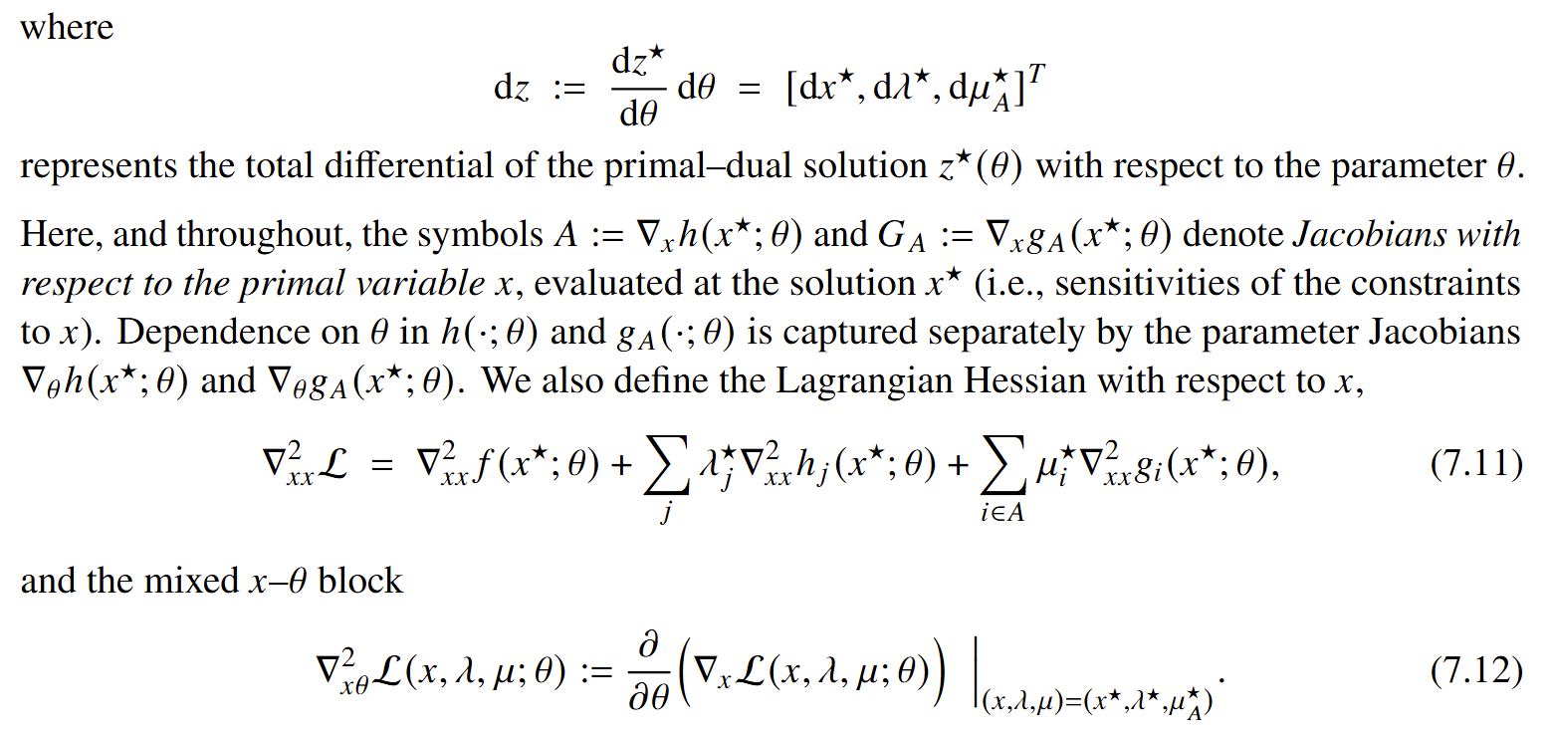
KKT-based Differentiation

Slide 18
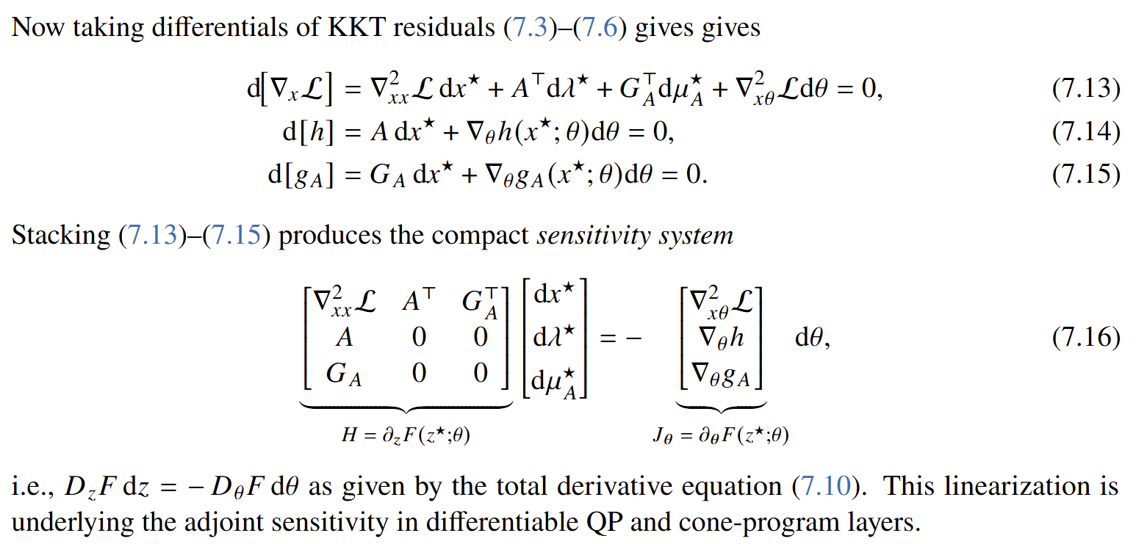
KKT-based Differentiation

Slide 19
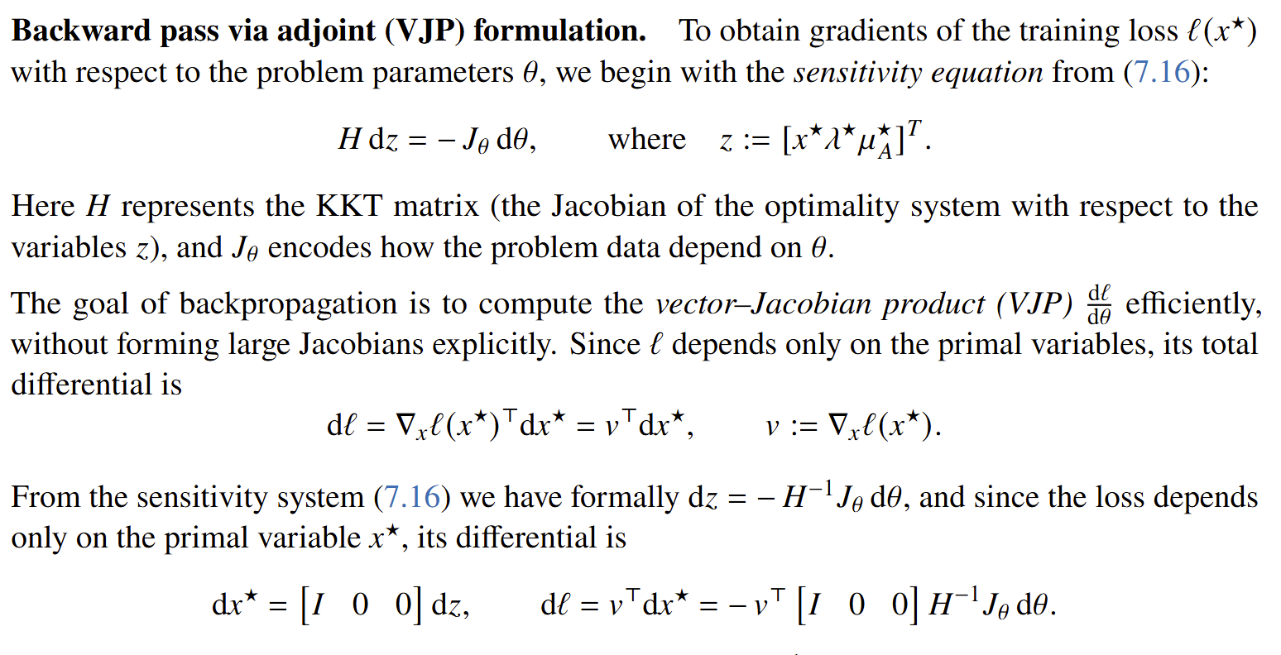
KKT-based Differentiation

Slide 20
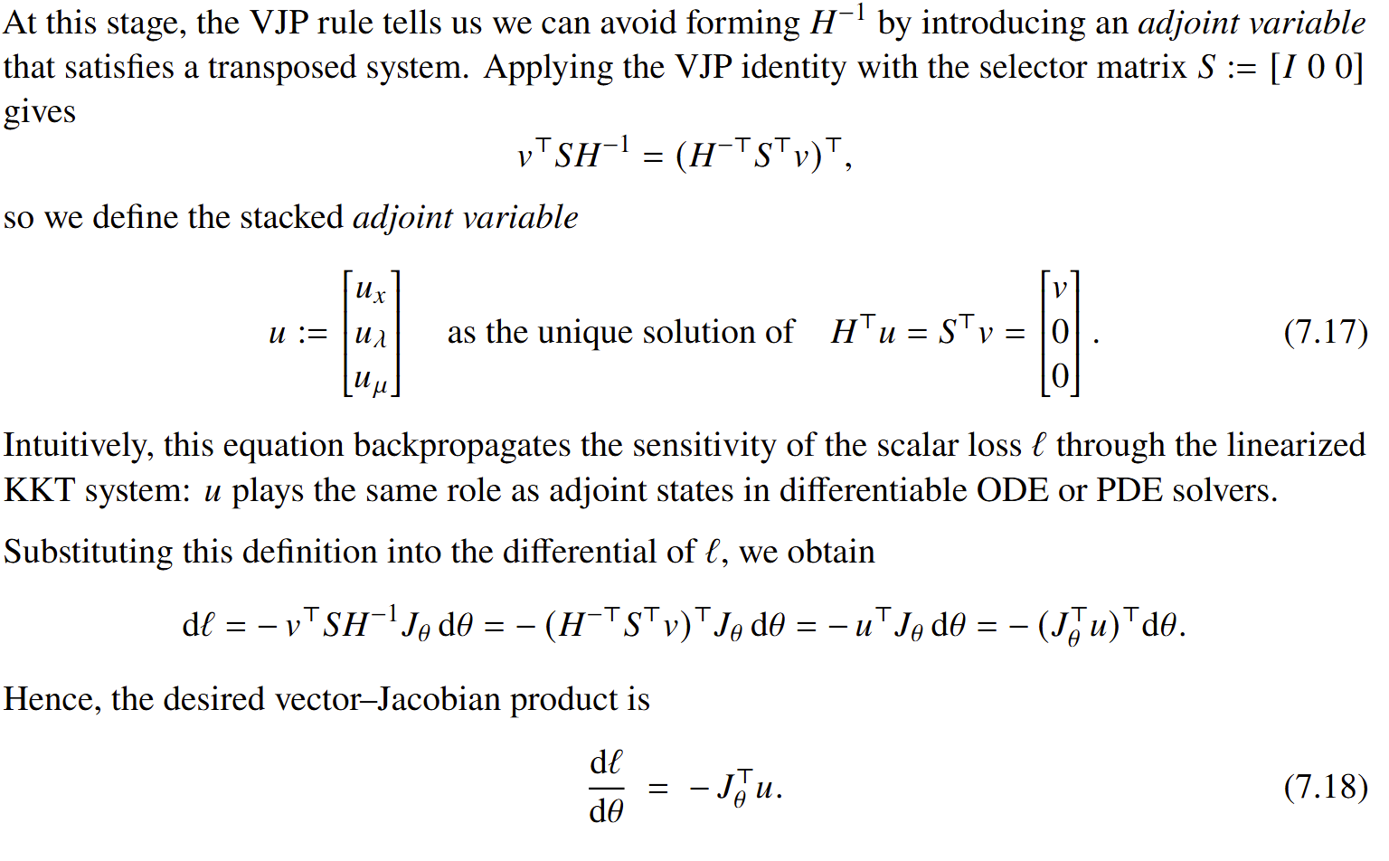
KKT-based Differentiation

Slide 21
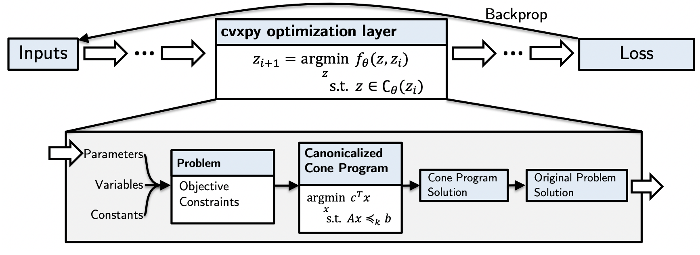
CVXpy Layers
https://locuslab.github.io/2019-10-28-cvxpylayers/
https://implicit-layers-tutorial.org/differentiable_optimization/
Agrawal, A. and Amos, B. and Barratt, S. and Boyd, S. and Diamond, S. and Kolter, Z., Differentiable Convex Optimization Layers, NeurIPS 2019

Slide 22


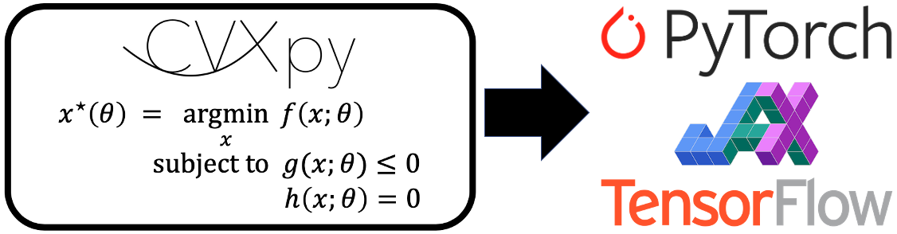



Differentiable Optimization and L2O Libraries
github.com/cvxpy/cvxpylayers
github.com/khalil-research/PyEPO
github.com/pnnl/neuromancer
Opt
DiffOpt
github.com/google/jaxopt
github.com/facebookresearch/theseus
github.com/jump-dev/DiffOpt.jl

Slide 23

L2O in NeuroMANCER Scientific Machine Learning Library
L2O Examples
L2O for a constrained optimization problem.
L2O for a quadratically-constrained optimization problem.
L2O for a set of 2D constrained optimization problems.
L2O for a constrained optimization problem with the projected gradient.
L2O with Cvxpylayers for differentiable projection onto the feasible set.
L2O with metric learning using Operator Splitting layers.
github.com/pnnl/neuromancer

Slide 24
Homework Assignment: Project Proposal
Project proposal: Write a 2-page long proposal 11pt font for your semester project written either using word or pdf generated using Latex.
The proposal must include following paragraphs:
Summary: Single sentence providing concise overview of the proposal.
Introduction: Provides context and problem statement. Answers what is the problem and why is the problem important.
Objectives: States clear and specific objectives of the proposal. Answers what we want to achieve.
Technical approach: Detailed explanation of how the project will be executed. Provides steps, strategies, and techniques to be used. Answers how are we going to achieve our objectives.
Expected outcomes: Key results expected from the project. Performance indicators and success metrics.

Slide 25
Week 11: Project Presentations and Evaluation
Projects cover 70% of the course grade!
Project proposal 20% - week 5
Project progress report 10% - week 8
Project final report 20% - week 10
Project presentation 20% - week 11
Project format.
Project technical report: 4 to 6 page long pdf document including references and figures.
Project presentation: ppt or pdf slides, 15 min time slot per student in week 11.
Admissible topics.
Application of selected SciML methods to problems inspired by real-world applications
e.g., L2O for large scale optimization of energy systems.
Development of new methods tackling some of the open challenges in SciML
e.g., novel way of utilizing PINNs in differentiable control for PDEs.
New theory supporting selected SciML methodology
e.g., convergence analysis of feasibility restoration layers in L2O.

